Slide 1
2025 SPRING MEETING

Slide 2
INTRODUCTIONS

Slide 3
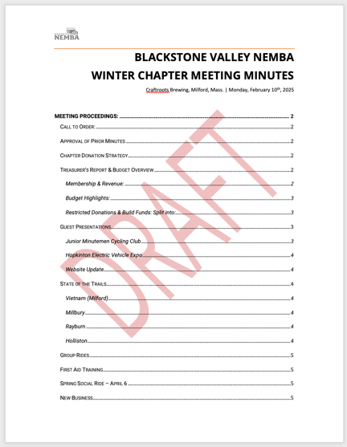
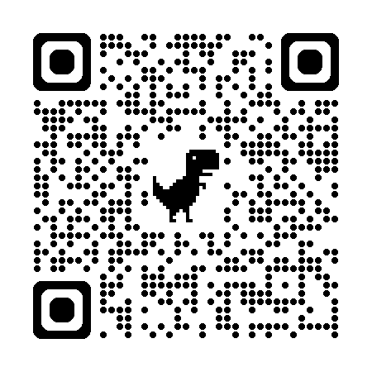
WINTER MEETING MINUTES APPROVAL
SCAN TO VIEW PRIOR MEETING MINUTES

Slide 4
LEADERSHIP DISCUSSION & MOTION

Slide 5
LEADERSHIP DISCUSSION & MOTION
PRESIDENT VACANCY: As a result of a vacancy in the President's role, the elected leadership board voted to appoint MIKE CARVALHO as President and KIM POWELL as Vice President.
MOTION / DISCUSSION: We ask now that this chapter either concur by motion with the action of the board or discuss alternatives.
AT LARGE: We now have a vacant at large position and will continue looking for candidates. Might we have anyone here this evening that would like to run?

Slide 6
TREASURER’S REPORT

Slide 7
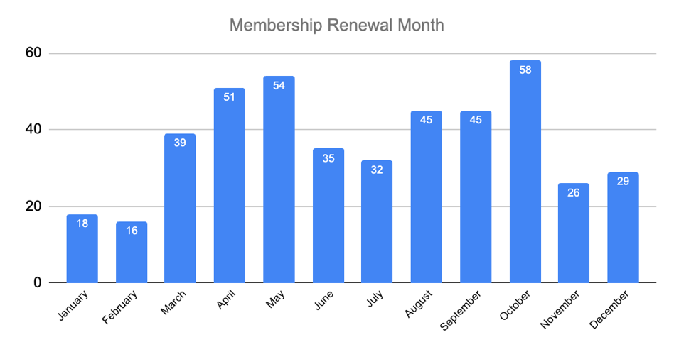
TREASURER’S REPORT || MEMBERSHIP

Slide 8
TREASURER’S REPORT || BALANCE
Banking Balance | 2025
______ Balance | $25,078.61
______ Balance | $31,035.62

Slide 9
TREASURER’S REPORT || INCOME
Income | 2025 Actual | 2025 Approved | 2024 Actual | 2023 Actual
Chapter Rebates and Direct Transfer Rebates | $1,203.00 | $14,000.00 | $9,917.66 | $14,753.89
Donations | $2,930.76 | $2,500.00 | $845.00 | $275.00
Events and Raffles Income | $8,011.35 | $8,000.00 | $1,638.95 | $9,591.22
Existing Funds | $0.00 | $26,675.00 | $0.00 | $0.00
TOTAL INCOME | $12,145.11 | $51,175.00 | $12,401.61 | $24,620.11

Slide 10
TREASURER’S REPORT || EXPENSES
Expenses | 2025 ACTUAL | 2024 APPROVED | 2024 ACTUAL | 2023 ACTUAL
Admin | $0.00 | $400.00 | $137.31 | $129.68
Cross-Chapter Donations | $0.00 | $1,000.00 | $0.00 | $2,650.00
Donations/Memberships/Sponsorships | $0.00 | $2,000.00 | $1,500.00 | $1,100.00
Education | $2,456.66 | $4,700.00 | $4,478.59 | $1,250.00
Equipment/Tools | $480.59 | $5,000.00 | $2,573.86 | $2,506.24
Event Food | $871.26 | $6,000.00 | $2,756.27 | $4,707.93
Events Expenditures | $32.50 | $4,500.00 | $2,344.16 | $3,654.08
Marketing | $262.04 | $800.00 | $677.50 | $291.55
Restricted Purpose Expenditures | $0.00 | $4,000.00 | $0.00 | $0.00
Long Term Projects (Holliston, Northboro, Millbury, Vietnam) | $0.00 | $8,000.00 | $1,956.88 | $1,557.92
Trail Work/Build Supplies | $2,970.50 | $8,000.00 | $5,032.92 | $3,258.65
TOTAL EXPENSES | $7,073.55 | $44,400.00 | $21,457.49 | $21,106.05

Slide 11
TREASURER’S REPORT || DONATION POLICY REMINDER
September
Member nominations open (2 categories)
October
Review eligibility + prepare proposed list
November
Chapter vote on recipients
Allocate funds:
70–80% to Land Managers & Trail Groups
Remainder to Community Organizations
December
Distribute donations + announce recipients
Note: Up to 10% of annual revenue may be donated per policy

Slide 12
TREASURER’S REPORT || 2 YEAR WORK LOG
PROJECT/AREA/RIDE | SUM OF AMOUNT
GRAFTON SILVER LAKE | $ 271.28
NORTHBORO PISGAH | $ 1,693.13
RIBBON CANDY | $ 782.02
VIETNAM | $ 2,109.87
WHD | $ 1,761.40
WHD PUMP TRACK | $ 2,374.88
GRAND TOTAL | $ 8,992.58

Slide 13
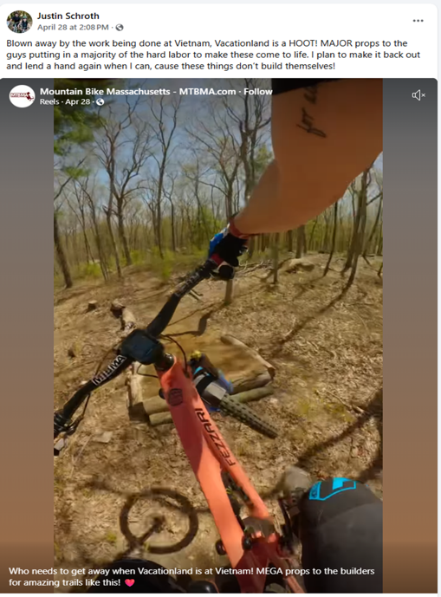
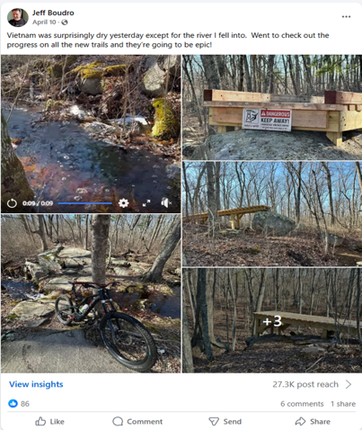
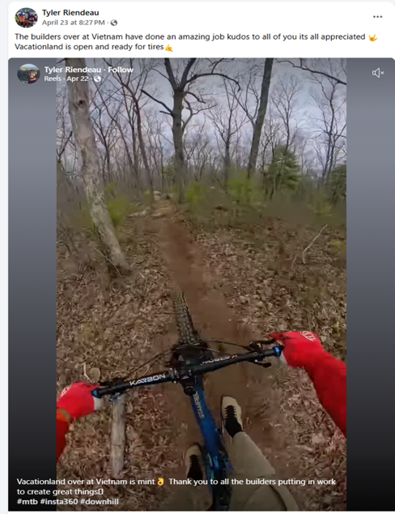
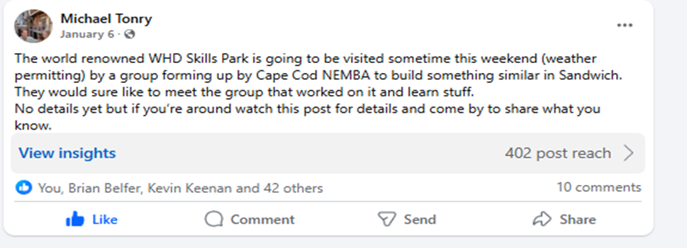

Slide 14
STATE OF THE TRAILS

Slide 15
STATE OF THE TRAILS || VIETNAM
TRAIL DEVELOPMENT:
"Vacationland" pro line is fully open,
"Powerline" pro line is opening soon
"B-Line" intermediate line is open, future extension planned.
Existing trail named "CRAFTROOTS CONNECTOR”
FINAL WORKDAY PLANNED FOR 5/18.
Will pause through Summer and start up again in the Fall
Two more "intermediate" lines planned.

Slide 16
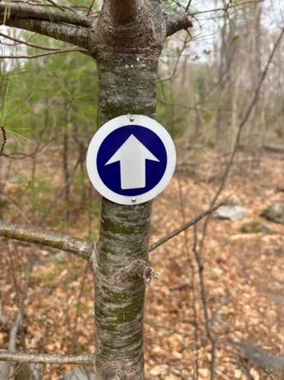
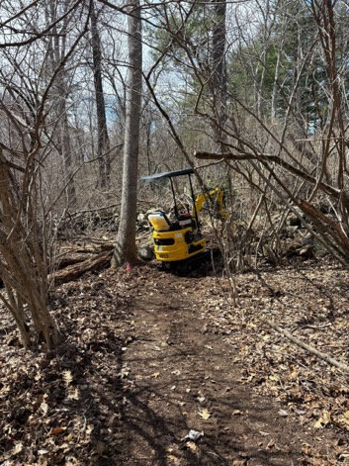
STATE OF THE TRAILS || MILLBURY
WITCH HAZEL:
Arrows added for improved flow
Culvert work pending

Slide 17
STATE OF THE TRAILS || NATICK & PISGAH
PISGAH
Small reroutes and maintenance underway
NATICK
Hunnewell Town Forest:
First day cut in the climb trail
Next build day on 5/17 to begin cutting in intermediate downhill trail

Slide 18
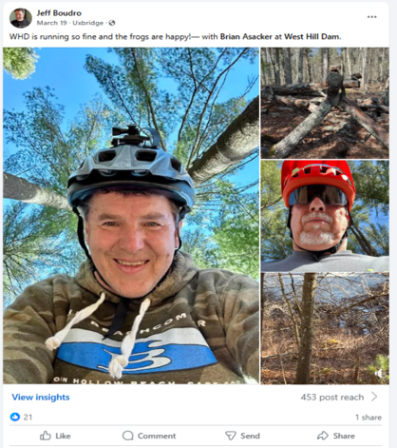
STATE OF THE TRAILS || WEST HILL DAM
PUMP TRACK & SKILLS PARK
March: Touch-up work completed on pump track + first jump
Landings on final jump and drops could use future refresh
No urgent needs — maintenance planned for later this season
Small reroutes and maintenance underway

Slide 19
RECENT EVENTS & RECAP

Slide 20
EVENTS || RECAP
FIRST AID TRAINING (MARCH 29)
20 Participants, CPR Certified
First Aid Kits available for 2024 attendees and Ride Leaders
SPRING SOCIAL (CANCELLED)
Event postponed
Updated planning for late April/early May 2026
BEGINNING BRIDGES

Slide 21
BLACKSTONE PATCH PRESENTATION

Slide 22
MEET YOUR RIDE AREA REPRESENATIVES

Slide 23
RIDE AREA REPS || WHO’S WHO
BERLIN | ETHAN BICKFORD | EBICKORD@NEMBA.ORG
UPTON, HOPKINTON, GRAFTON | LAURA ZIMMER | LZIMMER@NEMBA.ORG
MENDON TOWN FOREST | BILL DAKAI | BDAKAI@NEMBA.ORG
MILLBURY | KYLE GRENDELL | RYAN WALLNER | KGRENDELL@NEMBA.ORG
CALLAHAN STATE PARK | CHRIS FIALA | DAN BENDELL | CFIALA@NEMBA DBENDELL@NEMBA.ORG
MT PISGAH (NORTHBOROUGH & BERLIN) | BRIAN BELFER | ETHAN BICKFORD | BBELFER@NEMBA.ORG
UXBRIDGE, NORTHBRIDGE (GOAT HILL/BADLANDS) | MIKE TONRY | MTONRY@NEMBA.ORG
WEST HILL DAM | BILL DAKAI | BDAKAI@NEMBA.ORG
WEST HILL DAM - SKILLS PARK | BIAGIO CAUTILLI | BCAUTILLI@NEMBA.ORG
SHERBORN | STEVE BRANDT | SBRANDT@NEMBA.ORG
NOBSCOT | JUSTIN SCHROTH | BARRY KOSHERICK | JSCHROTH@NEMBA.ORG BKOSHERICK@NEMBA.ORG
DOUGLAS | MIKE TONRY | MTONRY@NEMBA.ORG
HOLLISTON | KEVIN KEENAN | MIKE CARVALHO | KKEENAN@NEMBA.ORG MCARVALHO@NEMBA.ORG

Slide 24
RIDE AREA REPS || WHAT, HOW & WHY
WHAT THEY DO:
Ride Area Reps (RaRs) serve as local points of contact
Responsibilities include trail updates, volunteer coordination, and ride planning
Reps build strong local connections and represent rider feedback
HOW CAN YOU SIGN UP?:
We’re always seeking new reps to support our local trails
Ideal reps: engaged riders with local knowledge and interest in stewardship
No experience required—just commitment
Contact an officer or email: blackstonevalley@nemba.org
CONNECT WITH YOUR LOCAL REP
Have trail questions or ideas? Your RaR is the first stop
Reps help coordinate rides, plan workdays, and relay feedback
Full list at blackstonevalleynemba.org

Slide 25
WEEKLY RIDES

Slide 26
WEEKLY RIDES || WHERE
WEEKLY RIDES — SCHEDULED… WEEKLY.
Weekly rides launching in multiple zones
Interested in leading? We’ll support you
Join planning threads on Slack or talk to a RaR
Potential "Retro Ride" - TBD

Slide 27
WEEKLY RIDES || WHERE
DESCRIPTION | Day of Week | Rotation | System(s) | Host(s)/Leader(s) | Start/End Dates
TBD | Monday | Bi-Weekly | Rayburn Brierly Stowe Meadows | @Kyle Grendell @Ryan Wallner
Blackstone Valley NEMBA - Wenakeening Woods | Tuesday | Weekly | Wenakeening Woods | @Jake Berry | April 29th - August 26th
TBD | Tuesday | Weekly | Different ride areas in the valley | Geezers @Bill Dakai | April - September
Blackstone Valley NEMBA - Douglas Beginner Ride | Wednesday | Weekly | Douglas State Forest | @Bill Rossi | April 9th - August 13th
Blackstone Valley NEMBA - Mt. Pisgah Intermediate-Plus Group Rides | Wednesday | Bi-Weekly | Mount Pisgah Rattlesnake Hill | @Brian Belfer @Florian Huber @Blake Carlson | April 23rd - July 16th
Blackstone Valley NEMBA - 2025 STBG Women's Ride Series | Wednesday | Bi-Weekly | Sherborn Town Forest | @Kristin Brandt @Kyla Carvalho | June 11th - August 20th
Blackstone Valley NEMBA - Vietnam Intermediate Group Ride | Thursday | Weekly | Vietnam | @Mike Carvalho @Kyla Carvalho @Kim Beagan | May 1st - August 28th
http://landrys.com/ | Thursday | Weekly | West Hill Dam | @Todd G. | April 10th - September 25th
Blackstone Valley NEMBA - Nobscot Friday Morning Ride Series | Friday | Weekly | Nobscot | @Barry Kosherick @Justin Schroth | Year round! (Weather permitting)
TBD | Friday or Thursday | TBD | Callahan | @Kim Beagan @Chris Fiala
TBD | TBD | TBD | Various | @Kristin Brandt | "Field Trips" led by women from STBG Ride Series (planning session in March)
TBD | Sat or Sun | Monthly | Various | @Laura Zimmer | April -Oct

Slide 28
NEMBA TRAIL SCHOOL

Slide 29
NEMBA TRAIL SCHOOL || HOW-TO
HANDS-ON TRAINING for sustainable trail design, maintenance, and safety
Great for Ride Leaders, Area Reps, and new volunteers. Open to All!
Learn tool use, erosion control, and best practices for working with landowners
INTERESTED IN ATTENDING IN 2025?
Let us know via Slack or email blackstonevalley@nemba.org
Empower your riding and trail-building skills with NEMBA

Slide 30
OPEN Q&A – MEMBER DISCUSSION

Slide 31
MEMBER DISCUSSION || Q&A
• Questions, concerns, and new ideas welcome
• Call for volunteers and event support
• Open floor for member input

Slide 32
NEW BUSINESS

Slide 33
MOTION TO ADJOURN

